Slide 1
Question-1
Refer this for code
https://github.com/shivamjoshi22/Homework_Assignment_Of_SP/blob/master/Lab3

Slide 2
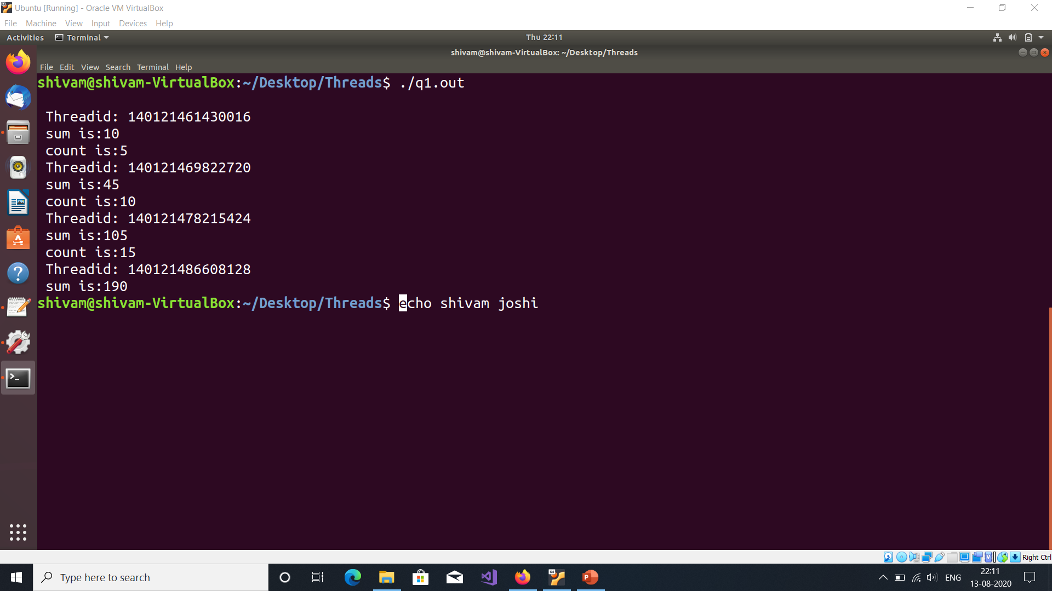

Slide 3
Question-2

Slide 4
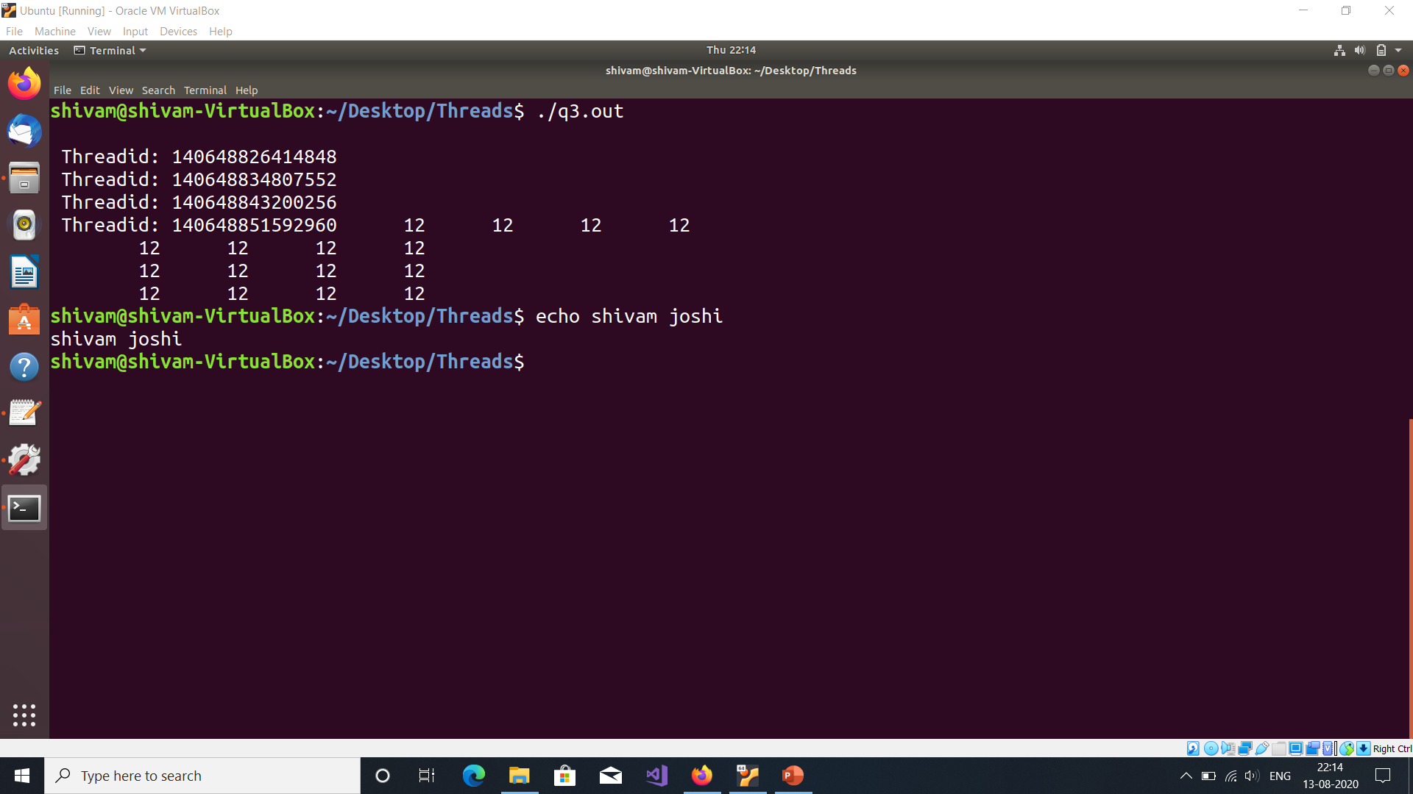

Slide 5
Question-3

Slide 6
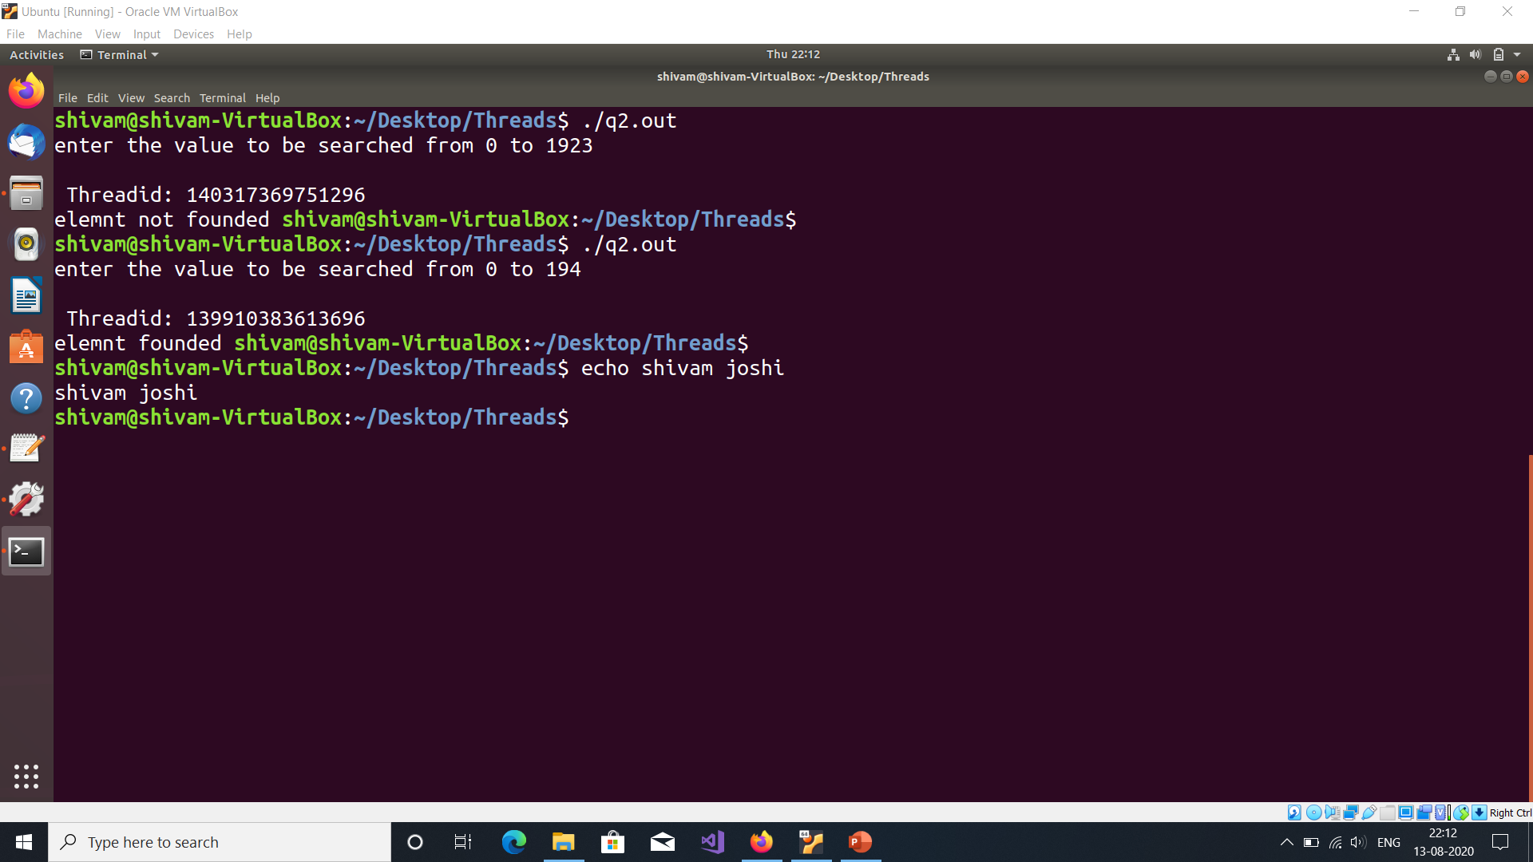

Slide 7
Question-4

